Slide 1
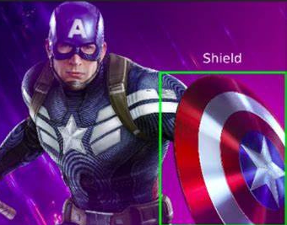



YOLO FAMILY
YOLOV3

Slide 2
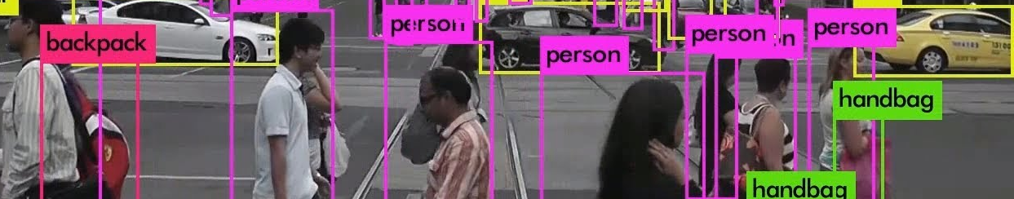

Topics to be covered
Introduction
Architecture
Prediction

Slide 3
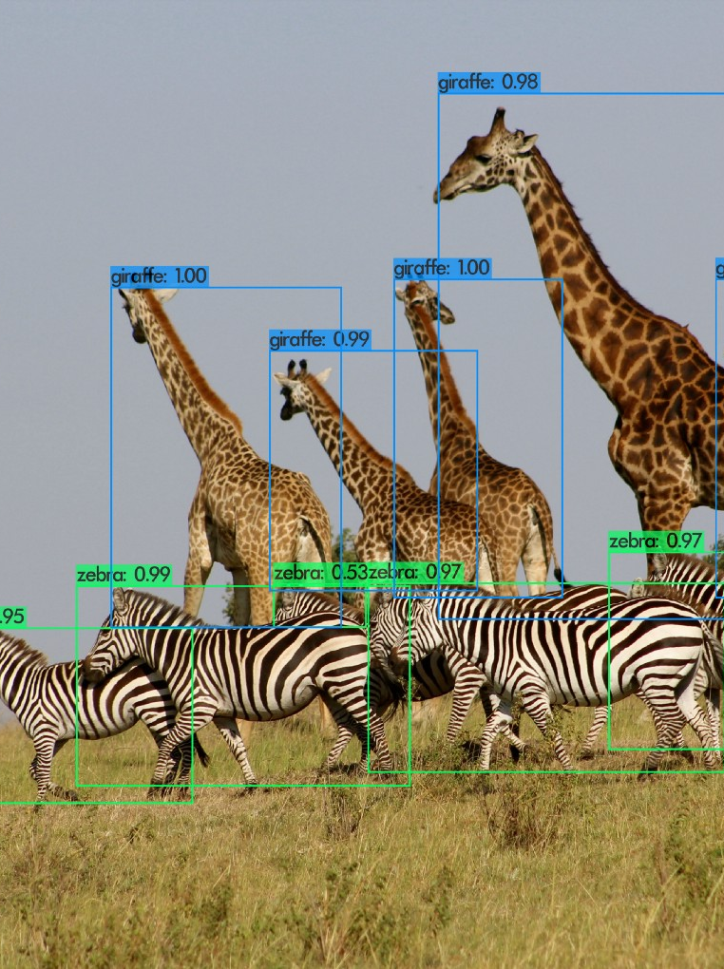
Introduction
YOLO v3 is a popular Convolutional Neural Network (CNN) for real-time object detection, published in 2018 by J. Redmon et al.
At its release time, it represented the state of the art for this task, ensuring accurate and fast performance like never before, and even today it is still a more than valid tool.
With a Titan X GPU, it can greatly process 320x320 images at 45 fps (22 ms for inference).

Slide 4
Introduction
YOLO v3 is the last work handled directly by J. Redmon, who can be considered the father of the YOLO family.
He is said to have left the research in this field after YOLO v3 was used for military purposes unwelcome to the author.
Moreover, he declared to recognize only YOLO v4 as the true worthy successor of YOLO v3.

Slide 5


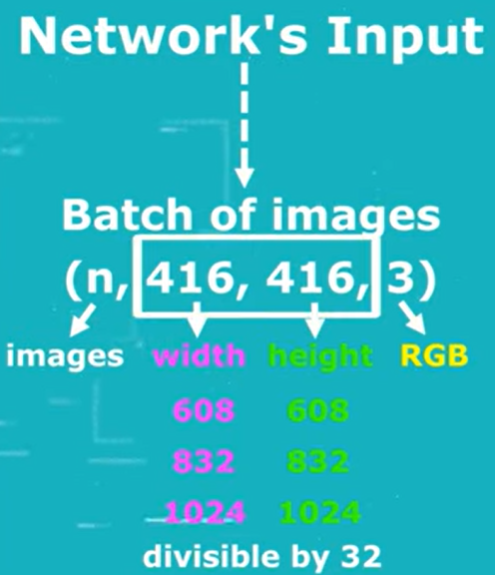
Input
YOLO v3 takes as input images of size 416 , 608, 832 or 1024 times the number of channels (3 for RGB images, 1 for grayscale ones).
(N,416,416,3) where N is batch size
These dimensions are not casual. They must be divisible by 32. Of course, the network is able to process images of any size, as long as they are resized to the aforementioned dimensions.
Additionally, you can choose to simply resize the entire image or resize and crop it in order to keep the original aspect ratio.

Slide 6
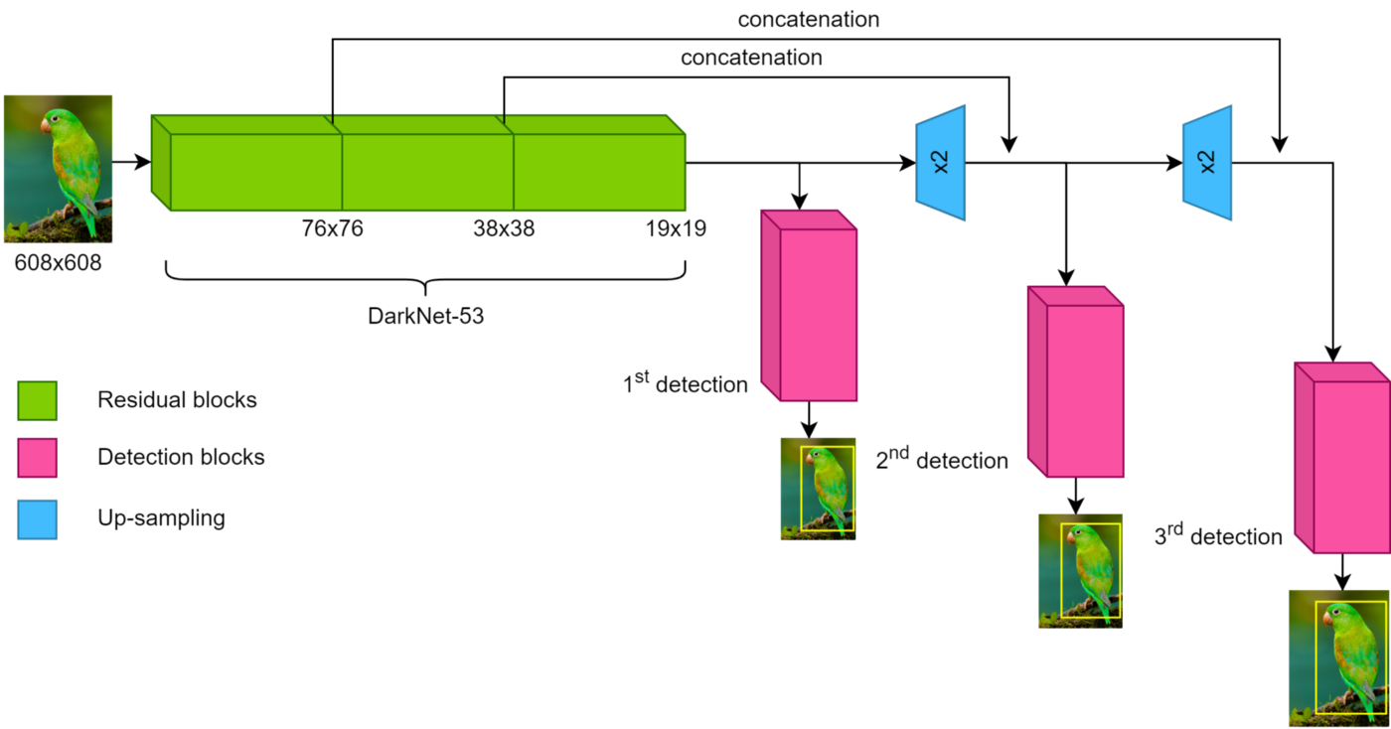
Darknet-19 classification network is used in YOLOv2 for feature extraction.
Now, in YOLOv3, a much deeper network Darknet-53 is used, i.e. 53 convolutional layers.
Architecture

Slide 7
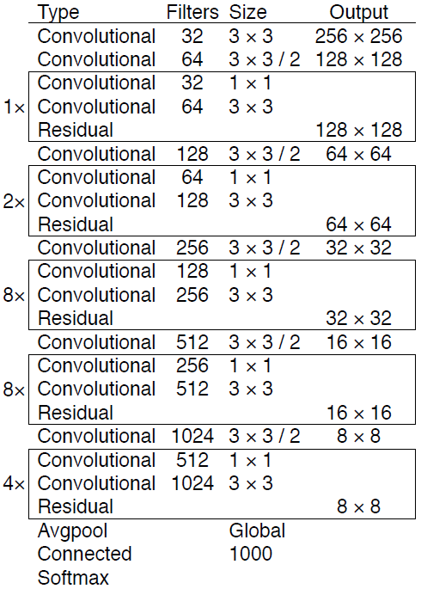
The new network is a hybrid approach between the network used in YOLOv2 (Darknet-19) and the residual network, so it has some shortcut connections.
Skip connections are another key concept of YOLO v3. It is empirically known that deeper networks struggle with learning simple functions such as the identity function.
Backbone
These functions are well estimated in the very first layers, but their quality degrades as the network gets deeper: Skip connections solve this problem. Usually, in a neural network, the output of a layer constitutes the input of the next one.
After training on classification the fully connected layer is removed from Darknet-53.

Slide 8
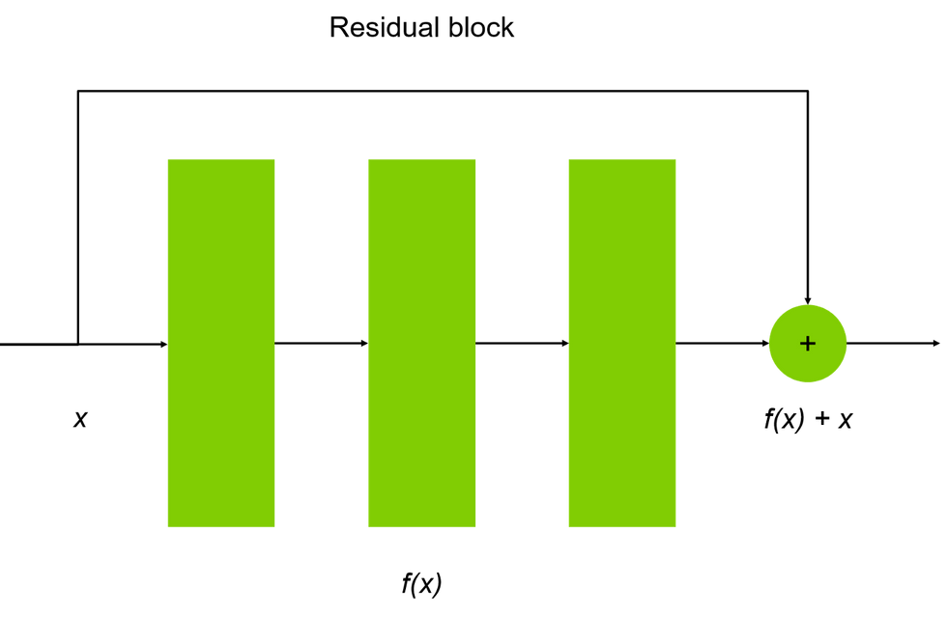
Skip Connections
Skip connections allow one layer output to bypass the immediately following layers, in order to be considered again later.
With this approach, the simpler information (referred to as residual block) that does not travel through the layers is stored; on the other hand, more complex information is extracted by passing through the layers as usual.
Subsequently, the simple and complex information is combined with a sum operation.
Going back to YOLO v3, it is made up of DarkNet-53 plus 53 additional layers, for an overall of 106 layers.

Slide 9
Skip Connections
YOLOv2 struggles with small objects. However, with YOLOv3 we see better performance for small objects, and that is because of using short-cut connections.
Using these connections method allows us to get more ﬁner-grained information from the earlier feature map.
However comparing to the previous version, YOLOv3 has worse performance on medium and larger size objects.

Slide 10
Predictions Across Scales
Unlike YOLOv1 and YOLOv2, which predict the output at the last layer, YOLOv3 predicts boxes at 3 different scales as illustrated in the below image.
At each scale, YOLOv3 uses 3 anchor boxes and predicts 3 boxes for any grid cell. Each object is still only assigned to one grid cell in one detection tensor.

Slide 11
Predictions Across Scales
Features are extracted from these scales like FPN. Several convolutional layers are added to the base feature extractor Darknet-53.
Next, the feature map is taken from the previous 2 layers and is upsampled by 2×. A feature map is also taken from earlier in the network and merge it with our upsampled features using concatenation. The last of these layers predicts the bounding box, objectness and class predictions.

Slide 12
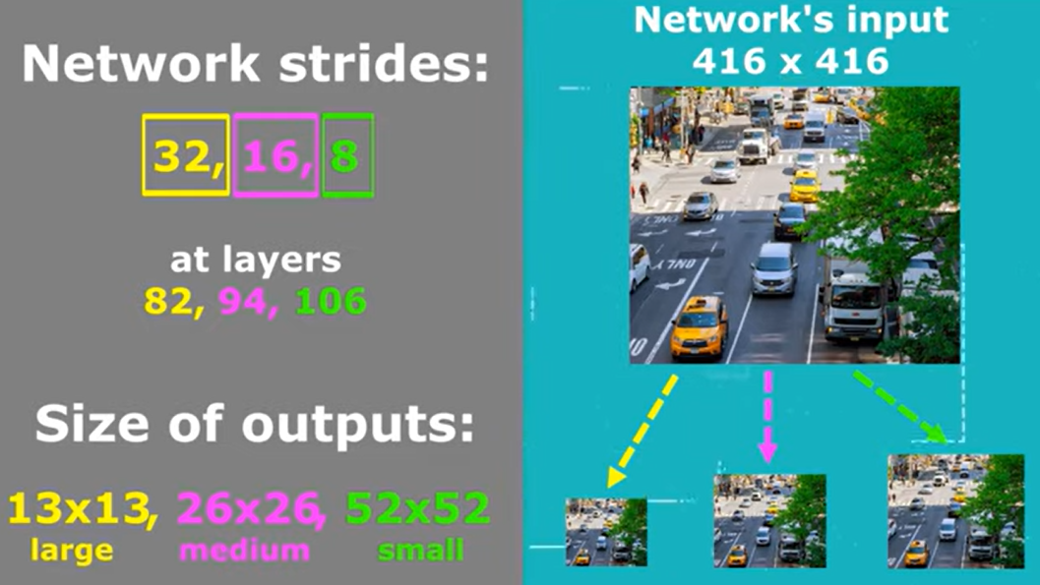
Predictions Across Scales
Passing through DarkNet-53, the extracted feature maps are scaled to the sizes 76x76, 38x38 and 19x19, by using strides with values 8, 16 and 32 respectively for an input size of 608.
Note that the input size of 608 is perfectly divisible by 32, allowing to achieve the scales just described. Therefore, the network could actually accept any input whose dimensions are a multiple of 32.
If we use an input of 416x416 and a stride of 32,16,8 at layers 82,94 and 106 we can get an output of 13x13, 26x26 and 52x52.
Notice that we can detect objects of different sizes at different scales. Large objects are detected using the smallest of scale of 13x13 and small objects are detected using the scale of 52x52.

Slide 13
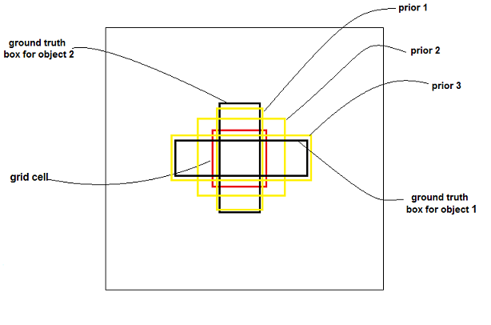
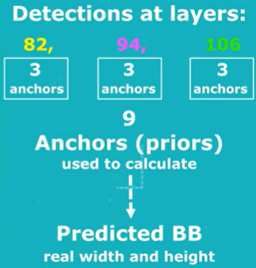
Anchor boxes describe the most recurring width/height ratios in the ground truth..
For each scaling step (76x76, 38x38 and 19x19), three anchor boxes are extracted, for an overall of nine boxes.
Anchor boxes are used at inference time to guide the definition of candidate bounding box size. In particular, bounding box size is expressed in terms of width and height ratio of the most suitable anchor box.
k-means clustering is used here as well to find better bounding box prior. Finally, on COCO dataset, (10×13), (16×30), (33×23), (30×61), (62×45), (59×119), (116×90), (156×198), and (373×326) are used.
Anchor boxes

Slide 14
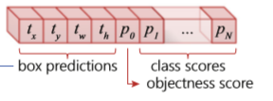
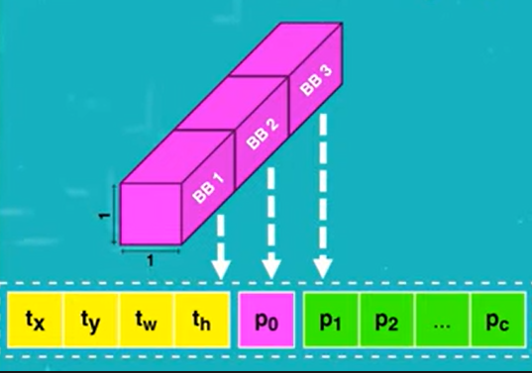
On COCO dataset, 3 boxes at each scales. Therefore, the output tensor is N×N×[B×(4+po+C)], i.e. 4 bounding box offsets, 1 objectness prediction, and 80 class predictions.
B stands for the number of bounding boxes identifiable for each image cell. In other terms, for each cell of the image YOLO v3 tries to predict B possible bounding boxes of belonging. In YOLO v3, B is equal to 3.
Bounding box predictions
p₀ the objectness score. It describes the probability that the cell of interest is the centre of the bounding box and is consequently more significant.

Slide 15
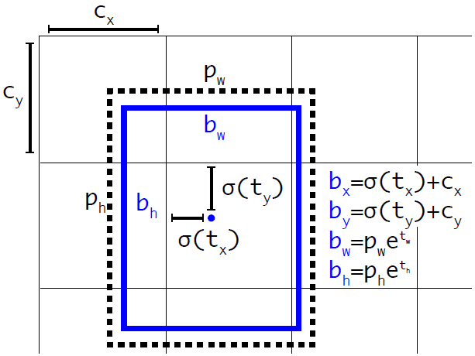
4 box predictions represent the number of attributes describing each candidate bounding box. They are:
- (tx, ty): the offset of the centre of the bounding box with respect to the cell of interest.
- (tw, th): the size of the bounding box, expressed as the scale of the most suitable anchor box
(for instance, if the anchor box has size 100x100 and the bounding box has size 90x80, then tw = 0.9 and th = 0.8).
Bounding box predictions

Slide 16
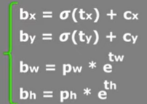
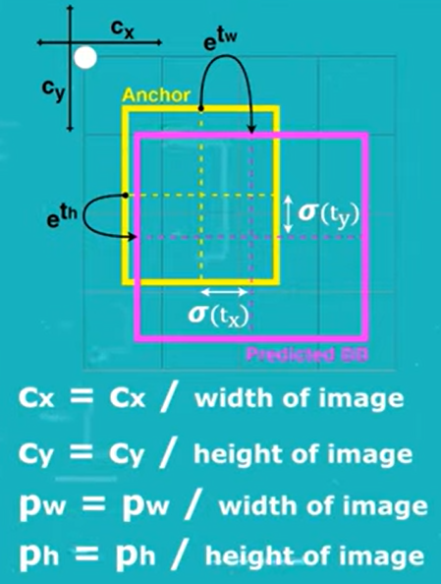
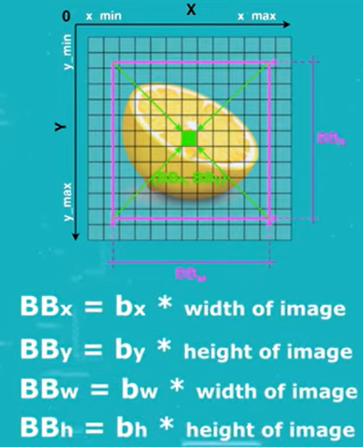
tx,ty,tw and th are predicted as offsets to anchor boxes. They are output after training the neural network.
All values must be normalized in order to avoid unstable gradients. cx, cy, pw and ph are divided by the width and height of the image respectively. tx and ty are passed through the sigmoid activation to make their values fall between 0 and 1.
Finally we need to multiply the bounding box predictions bx, by, bw and bh to get BBx, BBy, BBw and BBh which gives us absolute values.
Transforming the anchor box to predicted bounding box is called Log-space transform.
Bounding box predictions

Slide 17
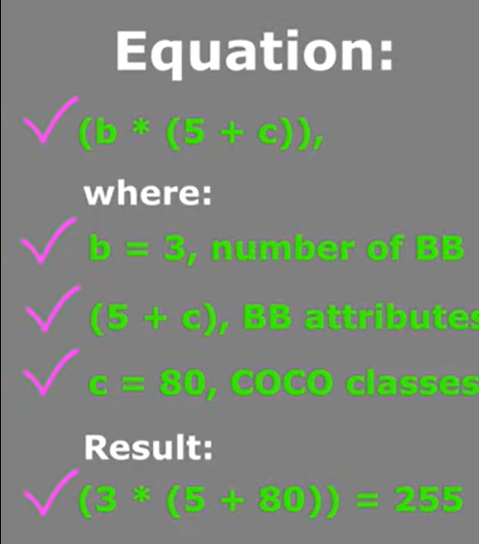
C stands for the number of recognizable classes. Therefore, C values {p₁, p₂, …, pc} describe the probability that the bounding box belongs to each of the known classes.
Since most of the YOLO v3 distributions are pre-trained on the dataset COCO, which describes 80 different classes, in our case we will say that C is equal to 80.
By using the equation (B * (5+C)) we can calculate the predictions for each grid cell. Each grid cell has B=3 bounding boxes, 4 box coordinates (tx,ty,tw,th), 1 objectness score (po) and 80 different classes (C).
(3*(4+1+80)) = 255
Bounding box predictions

Slide 18
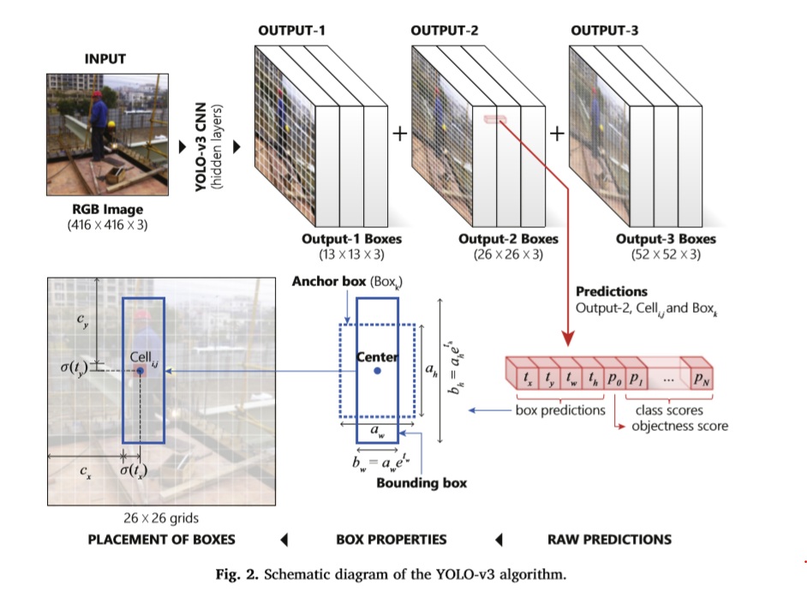
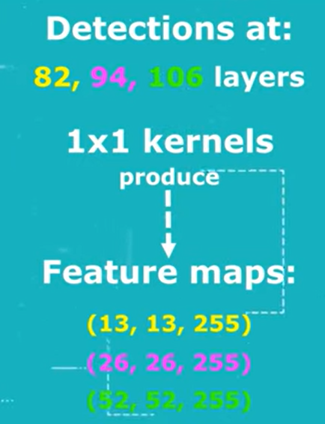
Detections are made at layer 82,94 and 106.
For an input size of 416x416x3 we can have an output of (13,13,255), (26,26,255),(52,52,255).
For an input size of 608x608x3 we can have an output of (19,19,255), (38,38,255),(76,76,255).
Output features

Slide 19
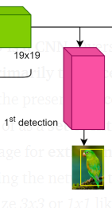
1st Object Detection
Let's assume the input is 608.The first detection occurs at the 82nd layer and it is responsible for recognizing the largest subjects within the image.
Here, after passing through DarkNet-53 the feature map has a size of 19x19. For the sake of simplicity, we will now refer to the feature map as an image of size 19x19, ignoring its depth.
Therefore, the image is subjected to a convolution operation with kernel size of 1x1. The output of this convolution will have dimensions of 19 x 19 x (B x (5 + C)), where 19x19 refers to the current width and height of the image. And (3 x (5+80) ) = 255 output for each grid cell.

Slide 20
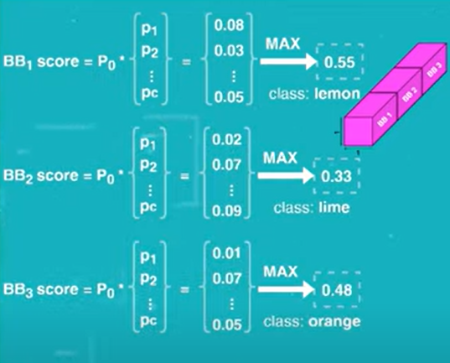
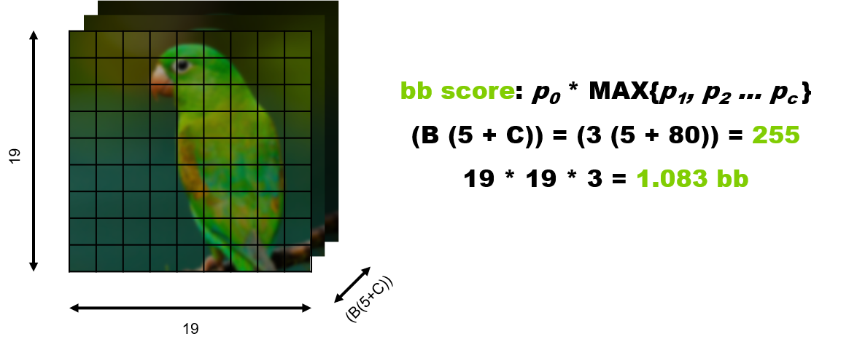
To recap, three bounding boxes are identified for each image cell, for an overall of 19x19x3 = 1083 bounding boxes at the first detection stage.
Each bounding box is described by the following values (tx, ty, tw, th, p₀, {p₁, p₂, …, pc}). The class score of each bounding box is given by multiplying the objectness score by the highest probability of belonging to a class (p₀ x MAX ({p₁, p₂, …, pc})).

Slide 21
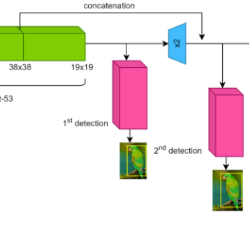
The image of size 19x19 is up-sampled to 38x38, and passes through several convolutional layers and skip connections. Before the second detection, the image is concatenated to the one coming from the 61st layer, having the same size of 38x38.
2nd Object Detection
This is because the current image can be thought of as a low-resolution image, whose features have been widely processed. Vice versa, the output of the 61st layer is an image with a higher resolution, whose features have not yet been sufficiently processed.
Therefore, combining the two images could potentially improve the detection results.
The second object detection occurs at the 94th layer and it is responsible for recognizing the medium-sized subjects within the image. It works exactly like the first detection and this time 38x38x3 = 4332 candidate bounding boxes are extracted.

Slide 22
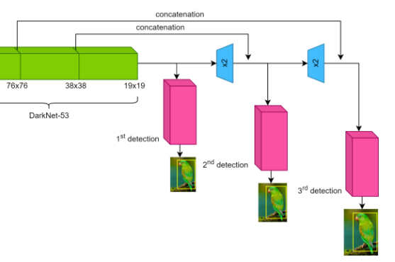
3rd Object Detection
In the same way, before the third detection, the image of size 38x38 is up-sampled to 76x76, it passes through further convolutional layers and skip connections and it is concatenated to the output of the 36th layer, having the same size of 76x76.
Finally, the third and last object detection occurs at the 106th layer and it is responsible for recognizing the smaller subjects within the image.
76x76x3 = 17328 bounding boxes are extracted at this stage.

Slide 23
Non Maximum Supression
Only one step away, we are nearly there! After the three stages of object detection are completed, we have an overall of 1083+4332+17328 = 22743 candidate bounding boxes, each with their own class score.
Of course, not all of them represent a good result, so we need to filter them using NMS. This can be done by using the algorithm we implemented in the previous section when we discussed about NMS.

Slide 24
Class Prediction
Softmax which was implemented in YOLOv2, is not used in YOLOv3 for class predictions.
Instead, independent logistic classifiers and binary cross-entropy loss are used. Because there may be overlapping labels for multilabel classification such as if the YOLOv3 is moved to other more complex domain such as Open Images Dataset.

Slide 25
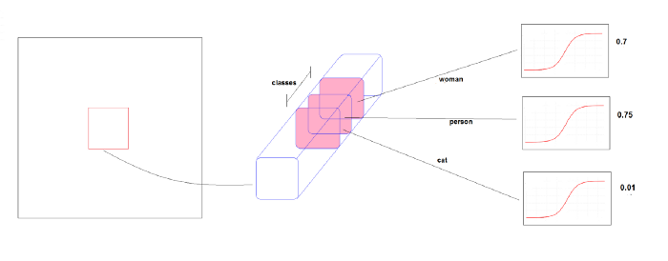
Multi Labels Predictions
In some datasets like the Open Image Dataset an object may have multi labels. For example, an object can be labeled as a woman and as a person.
In this dataset, there are many overlapping labels. Using a softmax for class prediction imposes the assumption that each box has exactly one class, which is often not the case (as in Open Image Dataset).
For this reason, YOLOv3 does not use a softmax; instead, it simply uses independent logistic classiﬁers for any class. During training, they used binary cross-entropy loss for the class predictions. Using independent logistic classiﬁers, an object can be detected as a woman an as a person at the same time.

Slide 26
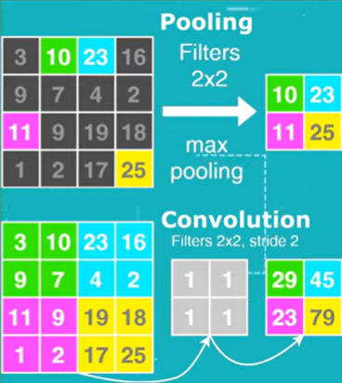
Notes
Both YOLOv2 and YOLOv3 also use Batch Normalization.
Leaky ReLU activation function was also used in YOLOv3.
There are no max pooling layers in YOLOv3. It uses convolutional layers with stride of 2 to reduce the spatial dimension. This will prevent loss of low level feature since max pooling only selects the maximum number and ignore the rest with in the sliding window.

Slide 27
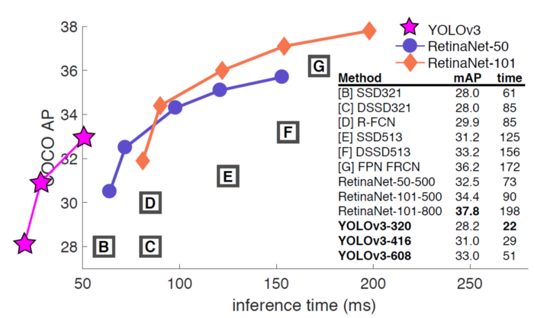
Performance
For overall mAP, YOLOv3 performance is dropped significantly.
Nevertheless, YOLOv3–608 got 33.0% mAP in 51ms inference time while RetinaNet-101–50–500 only got 32.5% mAP in 73ms inference time.
And YOLOv3 is on par with SSD variants with 3× faster.

